Slide 1

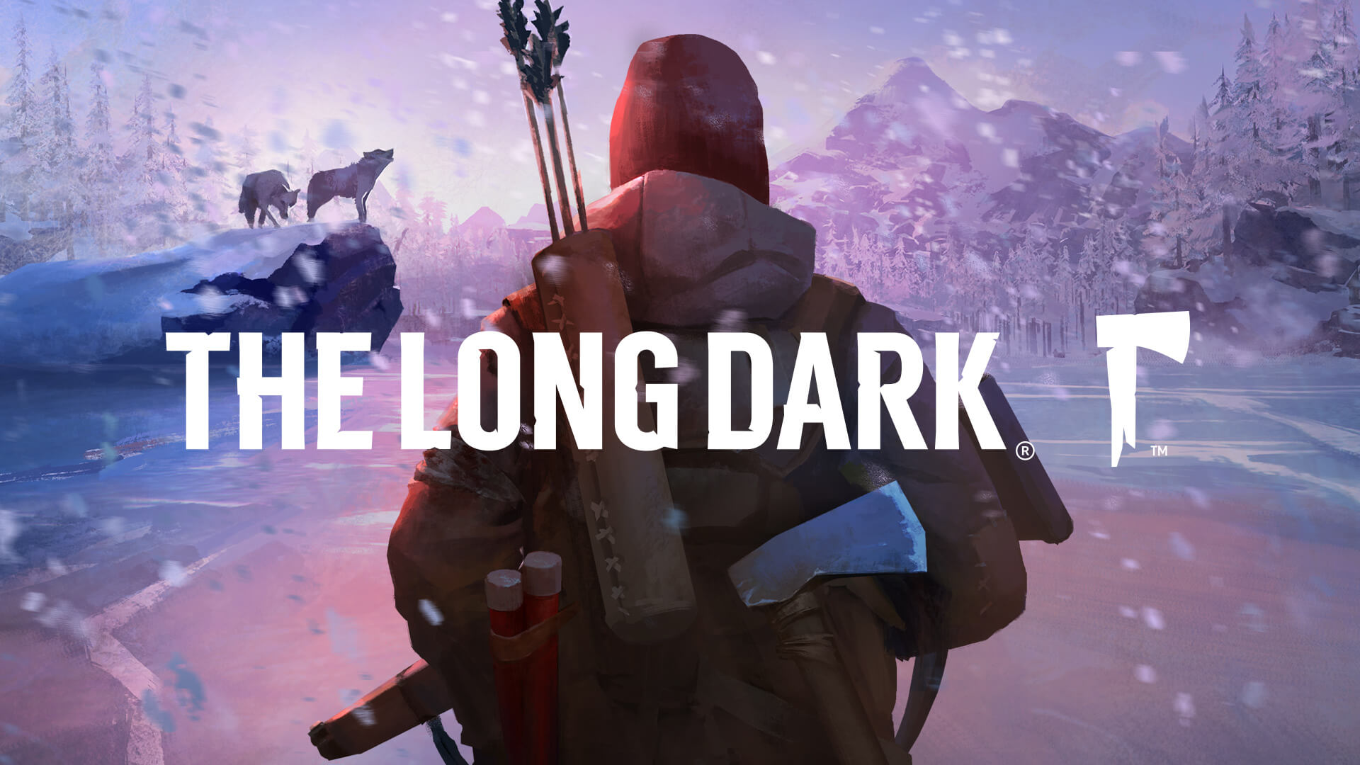

FROSTWOOD
CHRONICLES

Slide 3
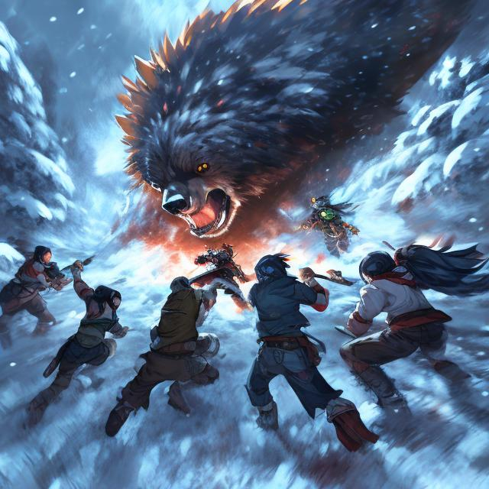

Slide 4
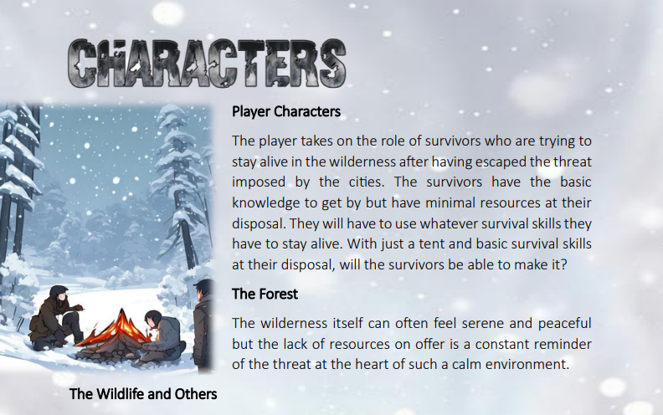
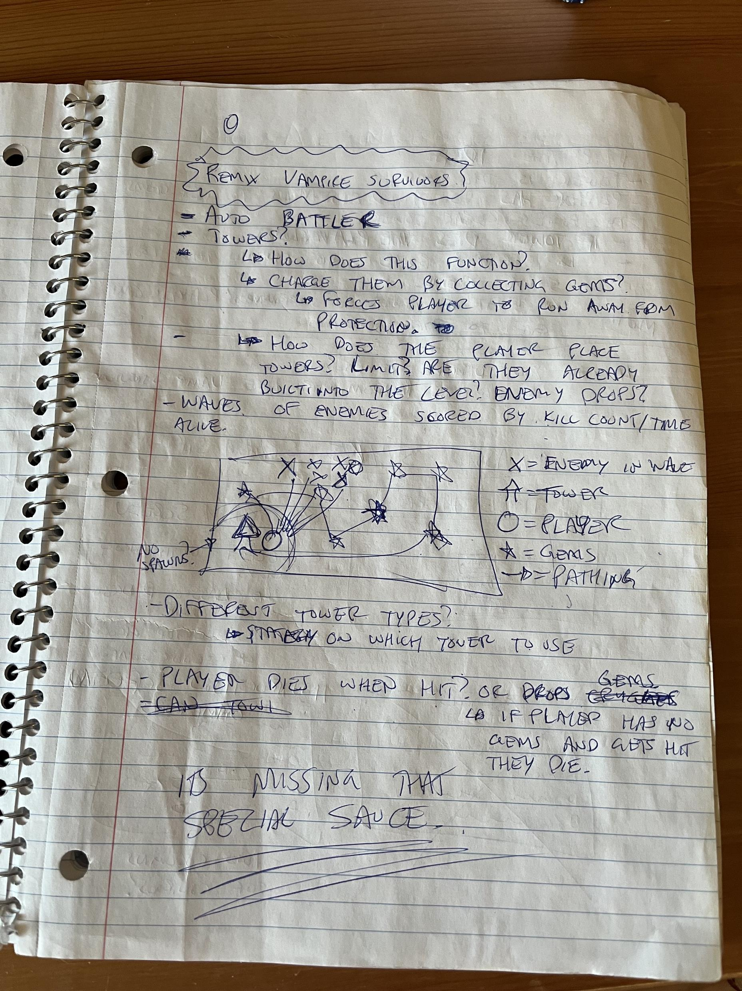
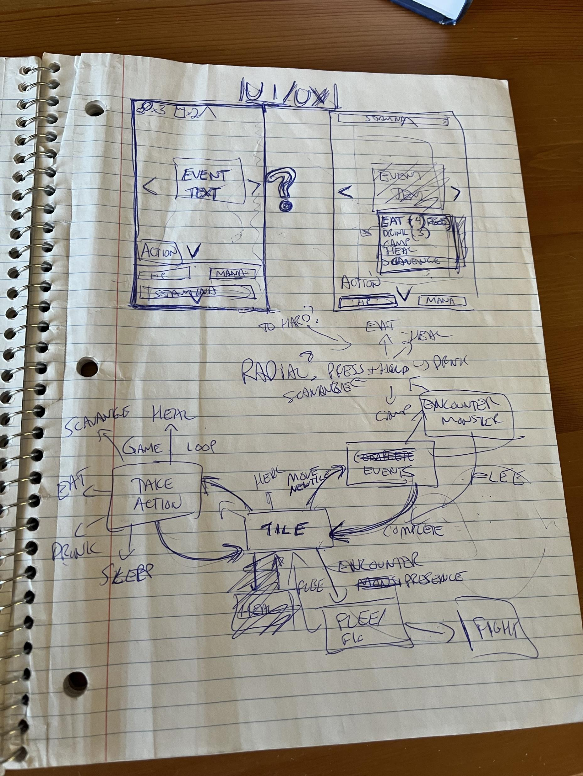
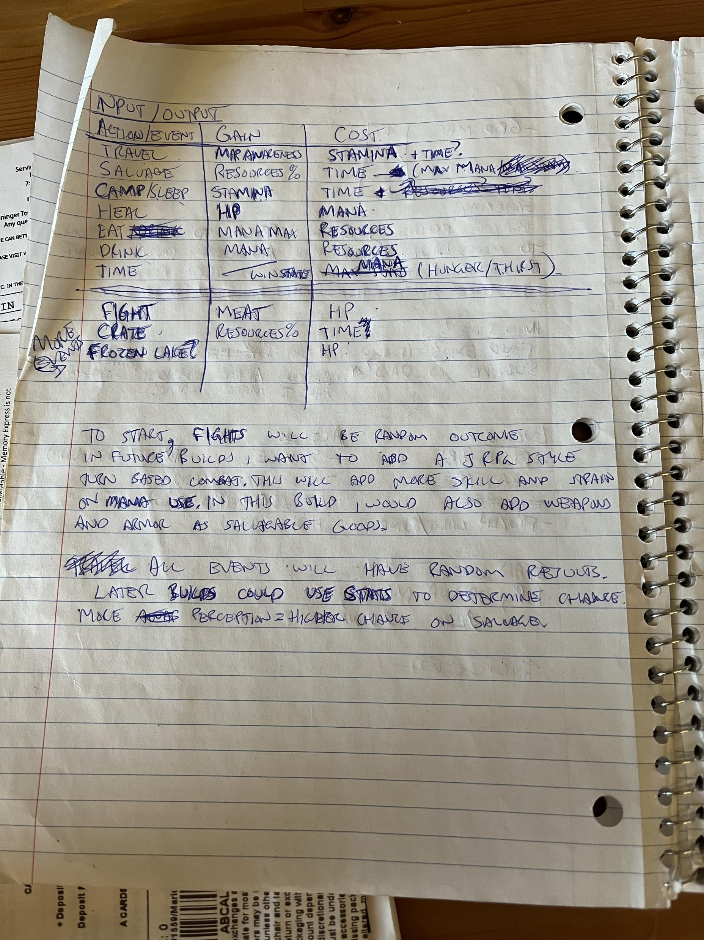
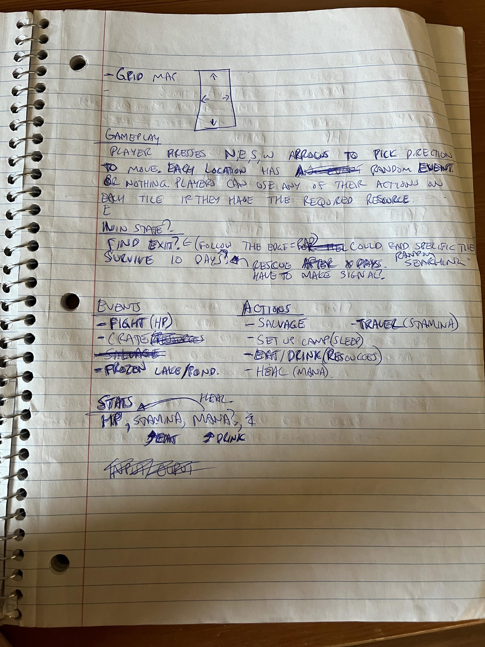
GAME DESIGN DOCUMENT

Slide 5
GAME DESIGN DOCUMENT

Slide 6

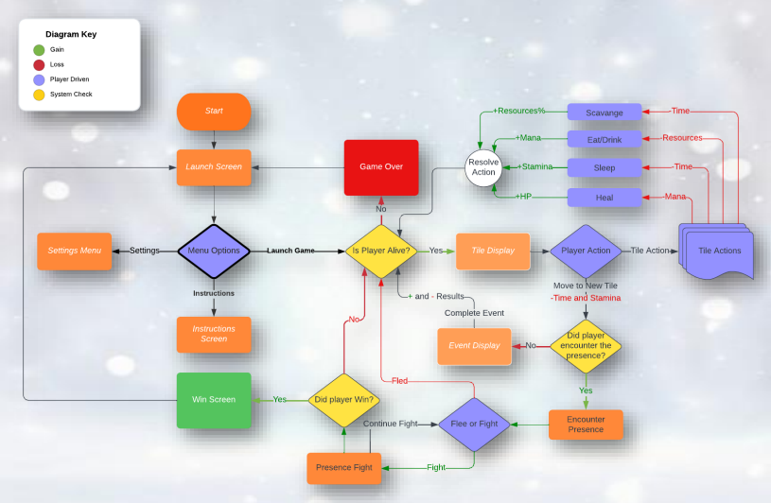
Players move from tile to tile making decisions at each tile. A series of actions is available to players on every tile. When moving to a new tile players will resolve an event before continuing.
GAME FLOW
Players move from tile to tile making decisions at each tile. A series of actions is available to players on every tile. When moving to a new tile players will resolve an event before continuing.

Slide 7
Players move from tile to tile making decisions at each tile. A series of actions is available to players on every tile. When moving to a new tile players will resolve an event before continuing.
GAME FLOW
Players move from tile to tile making decisions at each tile. A series of actions is available to players on every tile. When moving to a new tile players will resolve an event before continuing.

Slide 8
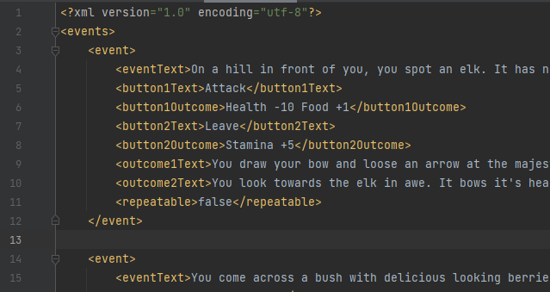
EVENT PARSER
Highly expandable
Customizable
Quick to produce new events
Does not require re-compiling code to add to the game.

Slide 9
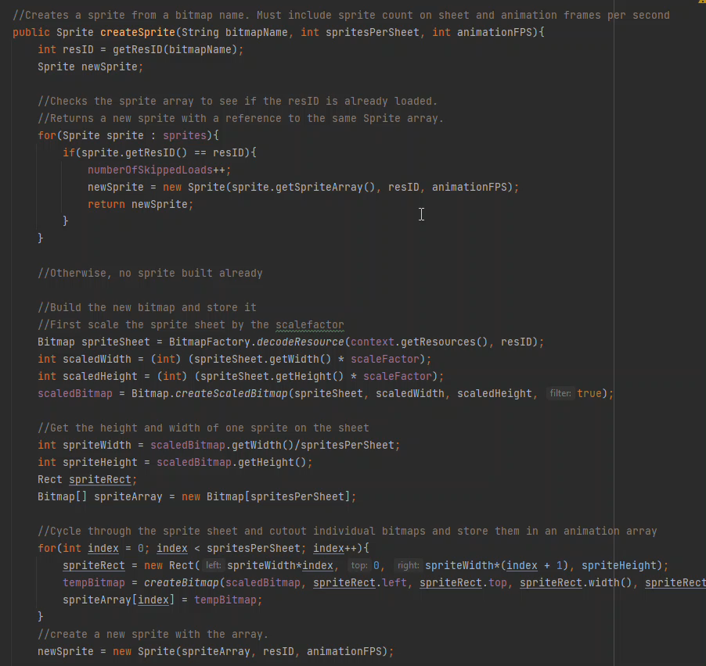
BITMAP HANDLER
Stores a reference to a sprite’s bitmap in the sprite.
Checks to see if bitmap is already in memory on object creation.
Instant calls to bitmap location every frame for drawing.

